Slide 1

PARENTAL LEAVE
REPORT
BY
Neel Balar
18th July, 2023

Slide 2

OVERVIEW
The analysis of parental leave data shows a significant difference between the paid/unpaid and maternity/paternity leaves offered, indicating a huge disparity between the pay scale and the gender role respectively.
We have been provided with a crowdsourced parental leave data from 1,601 companies across different industries, including paid/unpaid maternity and paternity leave weeks.
“We never know the love of a parent until we become parents ourselves.”

Slide 3


METHODOLOGY
Understand the data.
Clean the data.
Organize the data
Data analysis.
Conclusion.

Slide 4

GOALS
Identify problem background.
Determine which companies offer the most parental leave.
Determine the difference between the maternity and paternity leaves offered.
Determine the distribution of parental leaves.
Determine any noticeable differences between industries.

Slide 5

KPIs
Company Name and Industry.
Number of Paid and Unpaid Maternity leave offered by a company.
Number of Paid and Unpaid Paternity leave offered by a company.

Slide 6

SUM, IF, COUNT formulas
Formatting, Sorting.
Text to Column
Pivot Tables
Charts
Concepts Used

Slide 7

ANALYSIS
“The core advantage of data is that it tells you something about the world that you didn’t know before.”

Slide 8
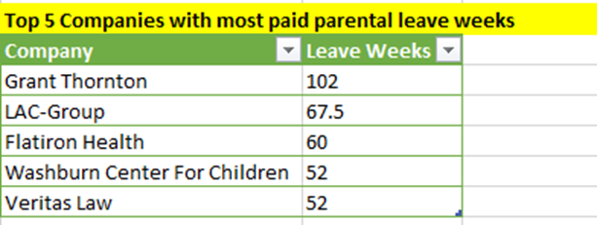
Which companies offer the most paid parental leave weeks?
These companies offer the most paid parental leave weeks.

Slide 9
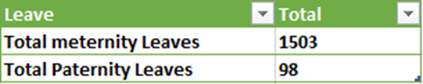
Is maternity leave typically longer than paternity leave?
Hence, Maternity Leave is typically longer than Paternity Leave.

Slide 10
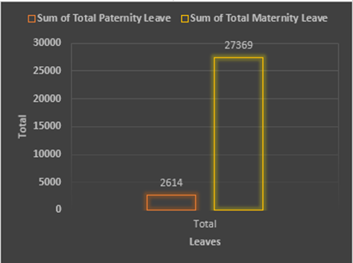
What is the distribution of parental leave weeks offered?
The distribution of maternity leave is more prevalent in various industries than the paternity leave.

Slide 11
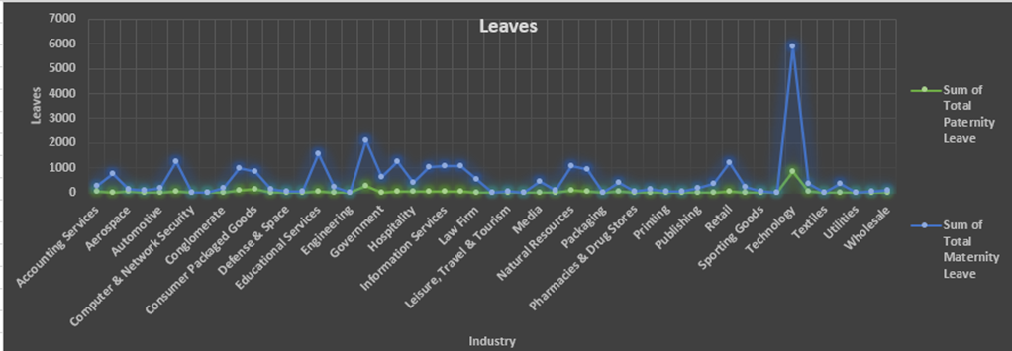
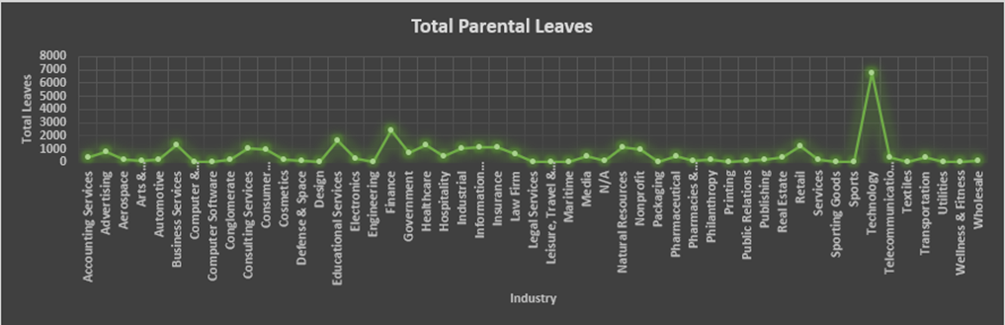
Are there noticeable differences between industries?
Hence, we can say that the maximum number of leaves is given by the Technology industry to its employees.
Women are offered more maternity leaves in Technology industry than the male parents.

Slide 12

CONCLUSION
Out of 1,601 companies from various industries maternity leave is about 91% whereas paternity leave is 9%, Technology followed by finance sectors have emerged out to be the leaders in supporting and providing parental leave policies and benefits. Among all the industries, a significant difference between the paid/unpaid and duration for maternity/paternity leaves offered have been observed.
Overall, the analysis of parental leave data provides valuable information to organizations, policy-makers, and stakeholders interested in promoting work-life balance, gender equality, and the well-being of employees and their families.

Slide 13



THANK YOU

